Slide 1
Cinema Finder
Calem Brennan Doyle

Slide 2
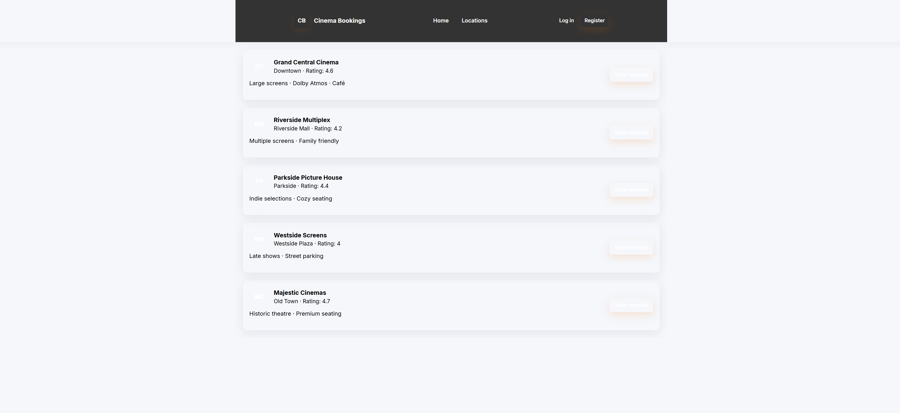
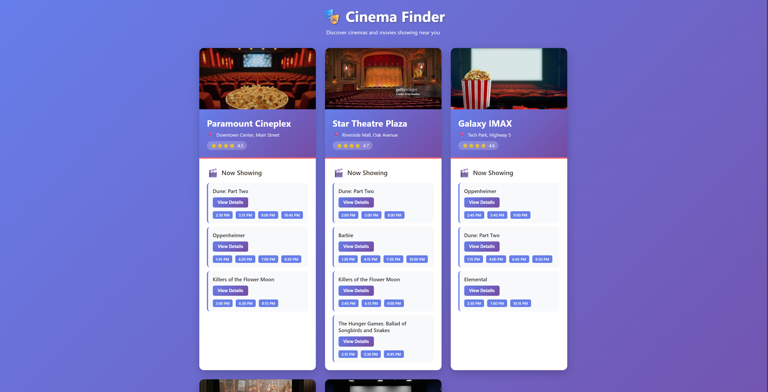
Development process
For the first iteration of the process I just let the ai do everything quickly with little detail just to see what it would make
Then for the second iteration I got the AI to recreate the website from scratch to see if it would make a better design ending up with these two different pages

Slide 3
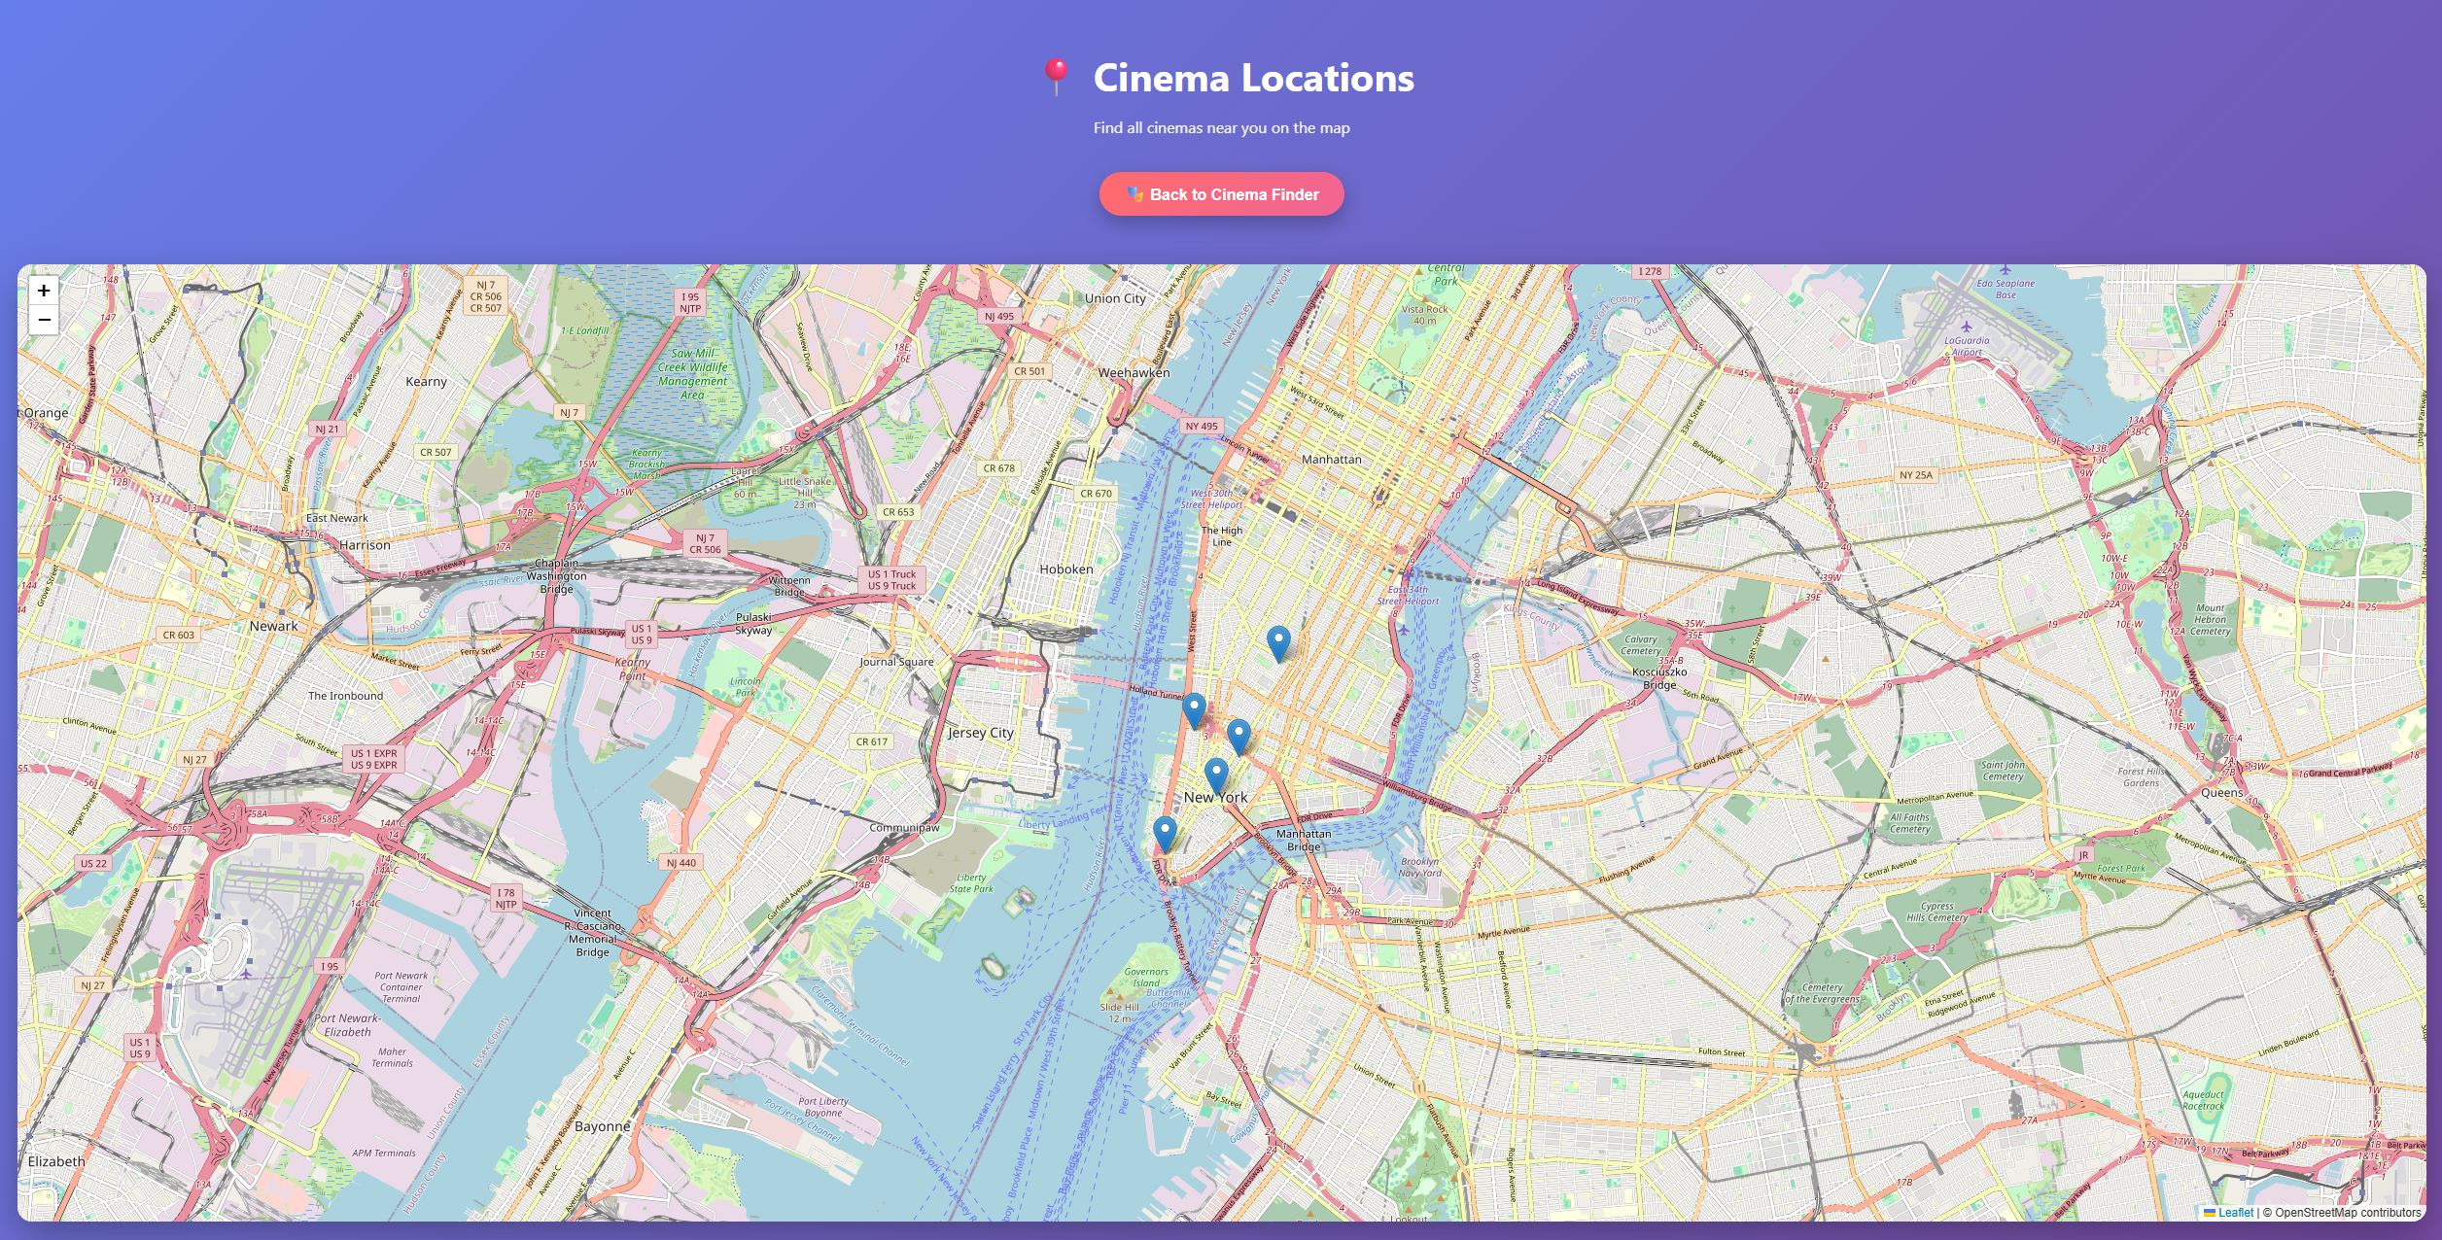
Development process (cont.)
I then used chatGpt to add the map using leaflet just to see how another ai would work when using already prebuilt code
Iteration 4 then went back to using copilot to create a login page

Slide 4
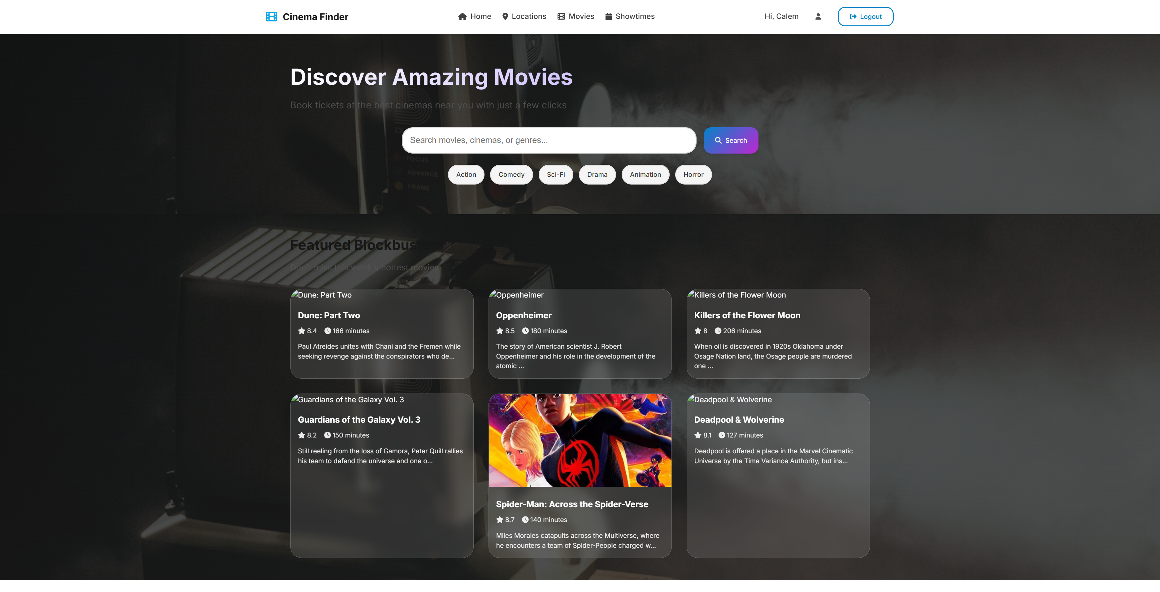
Development process (cont.)
For Iteration 5 and 6 I got openCode AI to completely add functionality that the users could use and then completely recreate the website to compare how different AI create user interfaces

Slide 5
What worked and didn't work
What worked: designing the page was pretty easy for all the AIs except for chatGPT which just put the map on the page, the AI were able to easily create user profile functionality and showing details
What didn't work: I had to go through the data a decent bit to debug and sometimes the ai would forget to add brackets to the end of code that I'd have to fix myself. By the end opencode still left a view buttons that just didn’t function properly

Slide 6
What did I learn
AI are scarily good at making webpages and at some degree the ai has enough intelligence to just add features that I hadn't even mentioned to it even when just handed 500 lines of code that it new nothing about chatgpt was still able to recode it for functionality with leaflet with minimal errors that I needed to fix which is very impressive

Slide 7
Ethical implications
If AI got any smarter or advanced I would be worried that AI would take web designers job which is ethically wrong that jobs can just be taken not to mention the environmental effect that AI has. I don't think it should be this easy for someone to just go to an ai and start prompting it to create a webpage for completely free
Not to mention how it takes the fun out of designing the webpage yourself, you're not able to mess with designs like as seen in iteration 6 the AI went from a somewhat expressive design with nice colours to a page with just two images, and a mostly white and all around bland design

